Slide 1
EST. 1450 · SUSSEX
Stoolball
A pocket guide for schools
stoolball.app

Slide 2
A QUESTION FOR THE CLASS
What sport is older than cricket and was played by milkmaids?
Hint: it has a wooden wicket on a stake, and the ball is bowled underarm.
stoolball.app
02 / 22

Slide 3
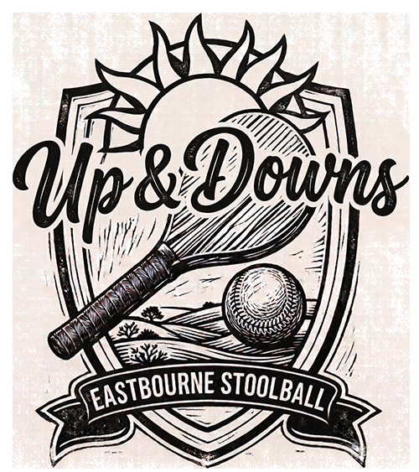
THE ANSWER
Stoolball.
A Sussex sport older than cricket.
Two teams. Fourteen overs each. A wooden wicket on a stake at chest height. The ball bowled underarm — and it arrives without bouncing.
stoolball.app
03 / 22

Slide 4
PAUSE FOR VIDEO
Watch: What is stoolball?
▶
Drop a 1–3 minute intro clip here · Google Slides → Insert → Video
stoolball.app
04 / 22

Slide 5
I.
THE STORY · 01 / 04
1450 · Milkmaids and milking stools
Stoolball was first recorded by name in the 15th century — more than a hundred years before cricket. Legend has it milkmaids played with their three-legged milking stools as targets, and a wooden milk bowl as a bat. That older name still survives: bittle-battle.
It was an Easter-time game. Often a courtship game. Played on village greens long before anyone thought of pavilions or whites.
stoolball.app
05 / 22

Slide 6
I.
THE STORY · 02 / 04
Shakespeare gave it a wink
In The Two Noble Kinsmen (c.1613), Shakespeare and John Fletcher had a character say she had been “playing stool ball.” To a Jacobean audience it was a knowing euphemism — proof the game was common enough across England to be a literary reference.
The first recorded match by name? Glynde Butterflies versus Firle Blues, 1866. Still in Sussex.
stoolball.app
06 / 22

Slide 7
I.
THE STORY · 03 / 04
1917 · Revived for wounded soldiers
Major William Grantham — Sussex landowner and KC — brought stoolball back as rehabilitation for soldiers convalescing at Brighton Royal Pavilion military hospital. He turned up to matches in a traditional Sussex round-frock and a beaver hat.
In 1923 he founded the Stoolball Association of Great Britain at Lord’s.
stoolball.app
07 / 22

Slide 8
I.
THE STORY · 04 / 04
Today · An officially recognised sport
The National Stoolball Association was founded in 1979 and renamed Stoolball England in 2010. In 2008 stoolball became an officially recognised sport.
Today it is played in mixed and ladies’ leagues across Sussex, Kent, Surrey and the Midlands. The Eastbourne Red Triangle Stoolball League has 18 sides across three divisions, fixtures every summer evening.
stoolball.app
08 / 22

Slide 9
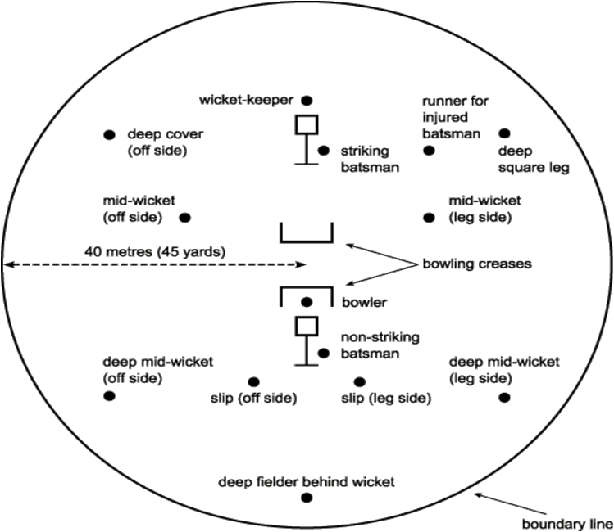
II.
THE SETUP · 01 / 04
Two wickets, 16 yards apart
The boundary sits 40 metres (45 yards) from the centre. Two wickets are pitched 16 yards apart, north-south where the ground allows.
The bowling crease is 10 yards from the batting wicket — a line one yard long, the bowler delivers from behind it.
stoolball.app
09 / 22

Slide 10
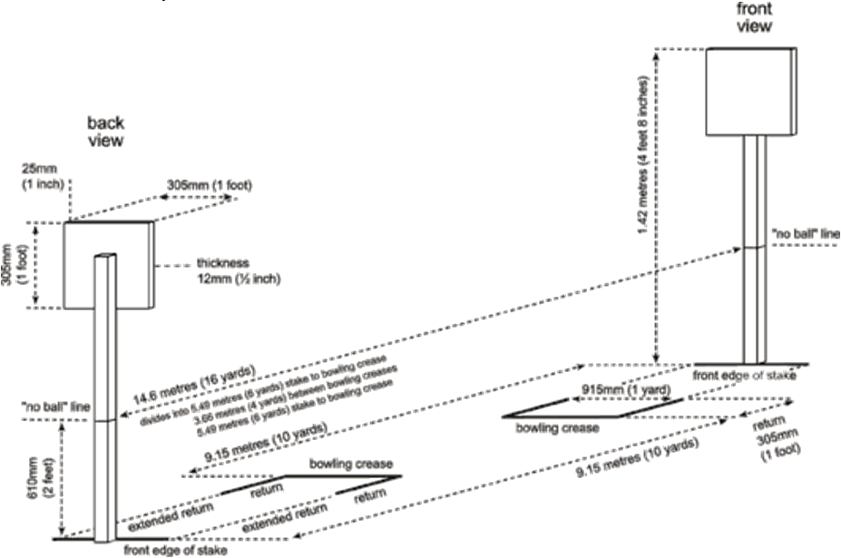
II.
THE SETUP · 02 / 04
A wooden board on a stake
The wicket is a board, one foot square and 12 mm thick, mounted on a stake so its top sits at 4 ft 8 in (1.42 m) — about chest height for most adults.
The bottom 24 inches of the stake is painted differently. That marks the no-ball line: the ball must arrive above it.
stoolball.app
10 / 22

Slide 11
II.
THE SETUP · 03 / 04
A frying-pan bat. A white ball.
THE BAT
THE BALL
19 in
70–85 g
maximum length · 7½ in across · round, short handle
weight · 7 to 7½ in around · white stoolball
Smooth wood, no splinters — that bit is a safety rule.
Roughly the size of a cricket ball, but lighter and softer.
stoolball.app
11 / 22

Slide 12
II.
THE SETUP · 04 / 04
No studs. No spikes. No gloves.
FOOTWEAR
HANDS
OTHER
Moulded soles only
No batting gloves
Pads & helmets OK
No removable studs or spikes. Moulded soles are the only assisted grip permitted.
Unless a fielder needs them on strict medical grounds, and the umpires have approved it in advance.
Protective kit is fine. The ball is softer than cricket and the bowling is underarm — heavy armour isn’t the point.
stoolball.app
12 / 22

Slide 13
III.
HOW TO PLAY · 01 / 05
Fourteen overs.
Eight balls each.
14
8
10y
OVERS PER SIDE
BALLS PER OVER
BOWLING DISTANCE
Light permitting. 10 minimum if cut short.
No-balls and wides don’t count — they’re re-bowled.
From bowling crease to the batting wicket.
stoolball.app
13 / 22

Slide 14
III.
HOW TO PLAY · 02 / 05
How runs happen
RUN
Made good
Run between the wickets. Touch the wicket or stake with bat or hand. Miss it and the umpire calls “short run.”
FOUR
Bounces in
Ball reaches or crosses the boundary after touching the ground. Four runs.
SIX
On the full
Ball clears the boundary without bouncing. Six runs. A fielder who catches it on the line still gives away a six.
BYE / NO-BALL
Extras
Bye = ball misses the bat, runs scored anyway. No-ball or wide = one run plus an extra delivery.
stoolball.app
14 / 22

Slide 15
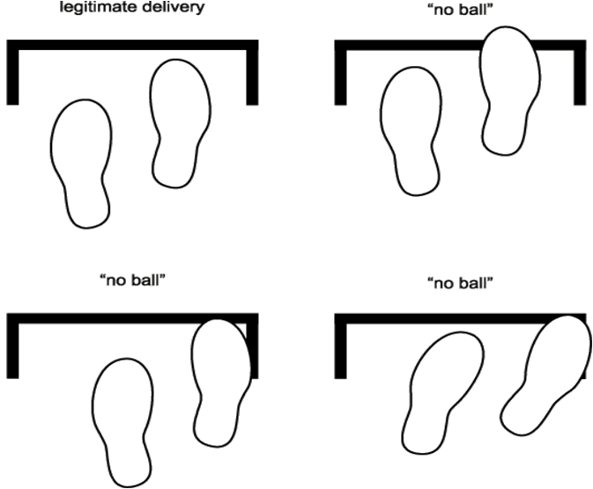
III.
HOW TO PLAY · 03 / 05
The bowler’s feet decide it
Stoolball bowling is underarm, the foot must stay behind the crease, and the ball must reach the wicket above the 24-inch line — without bouncing.
Any infraction = no-ball. One run plus an extra delivery.
stoolball.app
15 / 22

Slide 16
III.
HOW TO PLAY · 04 / 05
Six ways your innings ends
01
02
03
Bowled
Body before wicket
Caught
Ball hits the wicket on a legitimate delivery.
Your body (not the hand holding the bat) stops the ball hitting the wicket.
Clean catch. Not on the ground. Not over the boundary.
04
05
06
Run-out
Hit twice
Timed out
Out of your ground when the wicket is touched by the ball.
Hit the ball twice on purpose.
New batter hasn’t reached the wicket within one minute.
stoolball.app
16 / 22

Slide 17
III.
HOW TO PLAY · 05 / 05
What the umpire is doing with their arms
OUT
NO BALL
WIDE
FOUR
Index finger raised in front of face.
Arm raised sideways at shoulder height. Call “no ball”.
Both arms outstretched sideways. Call “wide”.
One arm crossing the body, side to side at shoulder height.
SIX
SHORT RUN
OVER
DEAD BALL
Both arms raised vertically above the head.
Bend one arm upwards and touch the nearest shoulder.
Call “over” and point to the centre of the bowling crease.
Both arms crossing and uncrossing in a downward position.
stoolball.app
17 / 22

Slide 18
PAUSE FOR VIDEO
Watch: A match in action
▶
Drop a 60–90 second match clip here · Google Slides → Insert → Video
stoolball.app
18 / 22

Slide 19
IV.
THE SPIRIT · 01 / 01
Captains responsible. Umpires final.
OUT OF BOUNDS
“Stoolball owes much of its appeal to the fact that it should be played not only within its rules but within the spirit of the game.”
No abusing opponents or umpires.
No appealing when you know the batter is not out.
No fake clapping under the guise of enthusiasm.
No advancing on the umpire.
No violence. None.
— OFFICIAL RULES, 2026 EDITION
stoolball.app
19 / 22

Slide 20
V.
HAVE A GO · WHERE TO START
A team near you, almost certainly.
The Eastbourne Red Triangle Stoolball League runs 18 teams across three divisions every summer. Up & Downs are the top-tier league side — known as British Queen until 2025.
AGE
COST
WHERE
8–70+
£1–£3
18
UP & DOWNS · EASTBOURNE STOOLBALL
Children start around 8 or 9. Plenty keep going into their 70s.
Match fee. An all-day Sunday tournament costs as little as £1.
Teams in the Eastbourne league. Find your nearest at stoolball.app.
stoolball.app
20 / 22

Slide 21
QUICK QUIZ · DISCUSS WITH THE PERSON NEXT TO YOU
Six questions. Three minutes.
01
In which century was stoolball first recorded by name?
02
Who revived stoolball in 1917, and why?
(Hint: long before cricket.)
(Hint: a Sussex landowner. A Brighton hospital. Soldiers.)
03
How tall is the wicket?
04
How many balls in an over? How many overs in a match?
(In feet and inches, then in metres.)
(Eight × fourteen = ?)
05
Name three of the six ways a batter can be out.
06
What can you not wear on your feet to play?
(Bowled, caught, run-out are the easy ones.)
(One word.)
stoolball.app
21 / 22

Slide 22
EST. 1450 · SUSSEX
Stoolball.
Older than cricket. Mostly forgotten. Still Sussex.
Learn more · stoolball.app
Companion to the Stoolball Modular Schools Pack

